Slide 1
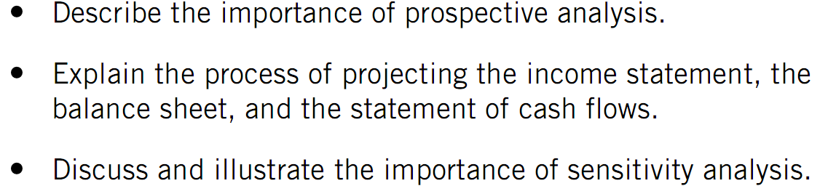
PROSPECTIVE ANALYSIS

Slide 2
Prospective Analysis
Importance
Security Valuation - free cash flow models require estimates of future financial statements.
Management Assessment - examine the viability of companies’ strategic plans.
Assessment of Solvency - useful to creditors to assess a company’s ability to meet debt service requirements, both short-term and long-term.

Slide 3
The Projection Process
Projected Income Statement
Sales forecasts are a function of:
1) Historical trends
2) Expected level of macroeconomic activity
3) The competitive landscape
4) New versus old store mix (strategic initiatives)

Slide 4
The Projection Process
Steps:
Project sales
Project cost of goods sold and gross profit margins using historical averages as a percent of sales
Project SG&A expenses using historical averages as a percent of sales
Project depreciation expense as an historical average percentage of beginning-of-year depreciable assets
Project interest expense as a percent of beginning-of-year interest-bearing debt using existing rates if fixed and projected rates if variable
Project tax expense as an average of historical tax expense to pre-tax income
Projected Income Statement

Slide 5
The Projection Process
Balance Sheet

Slide 6
The Projection Process
Income Statement

Slide 7
The Projection Process
Income Statement

Slide 8
The Projection Process
Projected Income Statement

Slide 9
The Projection Process
Steps:
Project current assets other than cash, using projected sales or cost of goods sold and appropriate turnover ratios (using ending balance).
Project PP&E increases with capital expenditures estimate derived from historical trends or information obtained in the annual report.
Projected Balance Sheet

Slide 10
The Projection Process
Steps:
Project current liabilities other than debt, using projected sales or cost of goods sold and appropriate turnover ratios (using ending balance)
Obtain current maturities of long-term debt from the long-term debt footnote.
Assume other short-term indebtedness is unchanged from prior year balance unless they have exhibited noticeable trends.
Projected Balance Sheet

Slide 11
The Projection Process
Steps:
Assume initial long-term debt balance is equal to the prior period long-term debt less current maturities from Step 4.
Assume other long-term obligations are equal to the prior year’s balance unless they have exhibited noticeable trends.
Projected Balance Sheet

Slide 12
The Projection Process
Steps:
Assume initial estimate of common stock is equal to the prior year’s balance
Assume retained earnings are equal to the prior year’s balance plus (minus) net profit (loss) and less expected dividends.
Assume other equity accounts are equal to the prior year’s balance unless they have exhibited noticeable trends.
Projected Balance Sheet

Slide 13
The Projection Process
Cash is computed as total assets less (1) and (2)
At this point, cash will be either be too high or too low. Long-term debt and equity stock are then adjusted for issuances (repurchases as) as appropriate to yield the desired level of cash and to maintain historical financial leverage.
Projected Balance Sheet

Slide 14
The Projection Process
Balance Sheet

Slide 15
The Projection Process
Income Statement

Slide 16
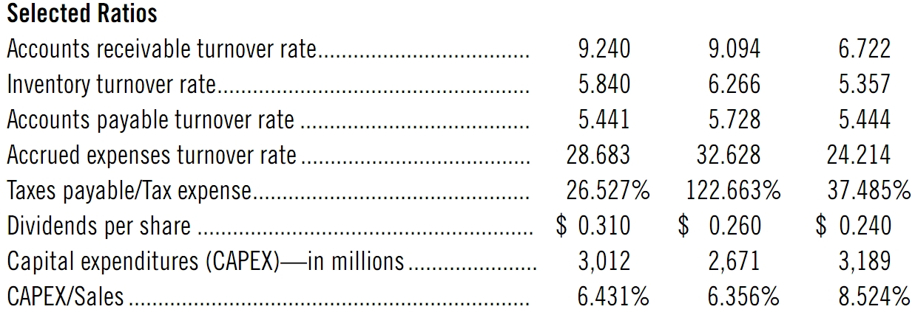

Slide 17
The Projection Process
Target Corporation Balance Sheet

Slide 18
The Projection Process
Cash is computed as total assets less (1) and (2)
If the estimated cash balance is much higher or lower, further adjustments can be made to:
invest excess cash in marketable securities
reduce long-term debt and/or equity proportionately so as to keep the degree of financial leverage consistent with prior years.
Projected Balance Sheet

Slide 19
The Projection Process

Slide 20
The Projection Process
What will happen if we assume increase in capital expenditures to 7.5% of sales in place of 6.431%?
Changes in assumptions in order to analyse their impact on financing requirements, return on assets and equity, and so on.
Analysts often prepare several projections to examine best (worst) case scenarios in addition to the most likely case.
Sensitivity Analysis

